Slide 1
Using VS Code

Slide 2
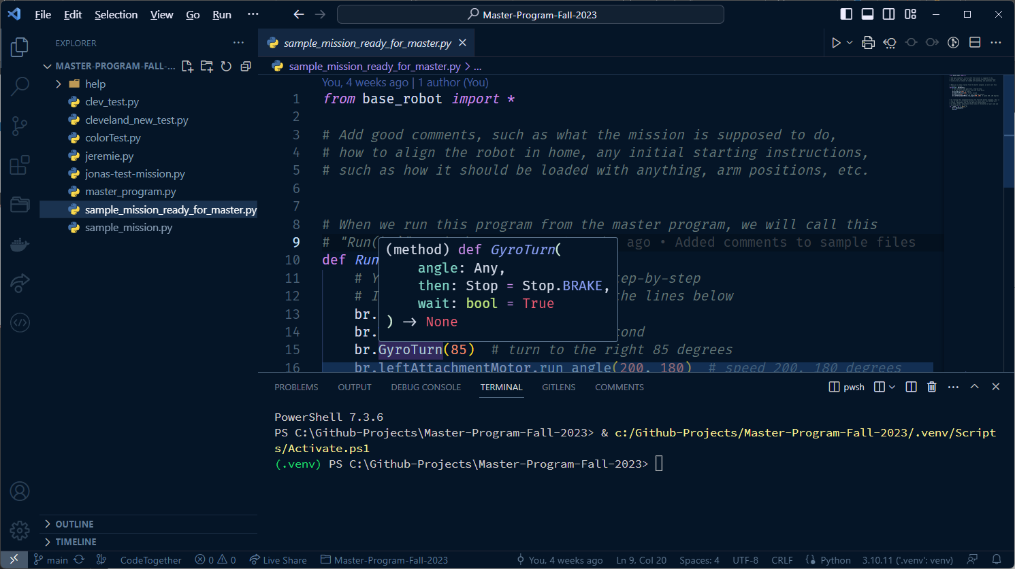

Slide 3
Open File Tabs
Files
Editor
Activity Bar
Terminal

Slide 4
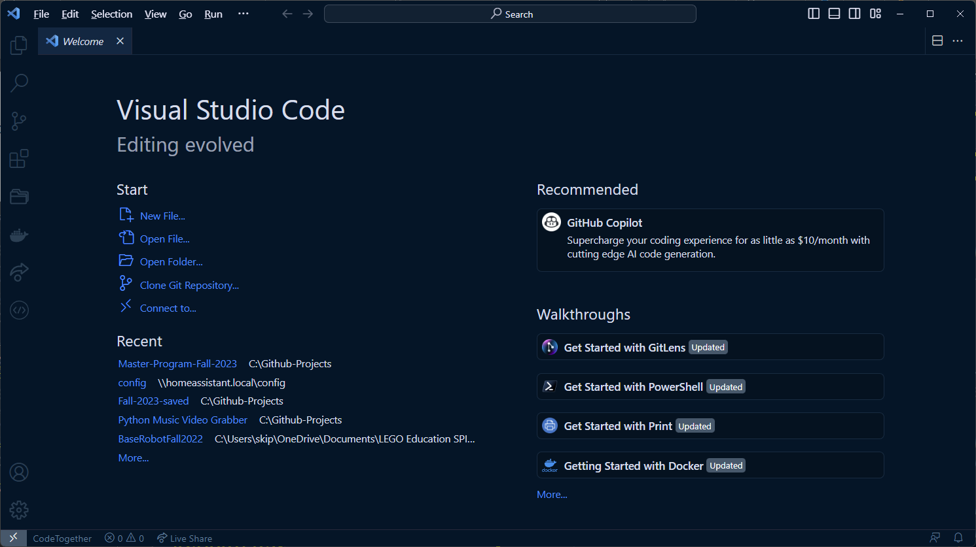

Slide 5
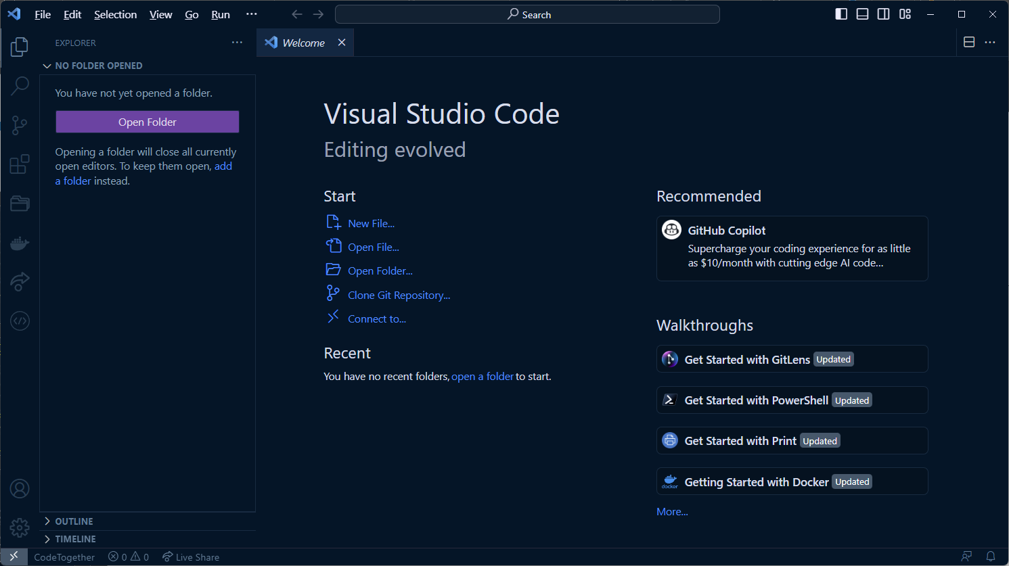

Slide 6
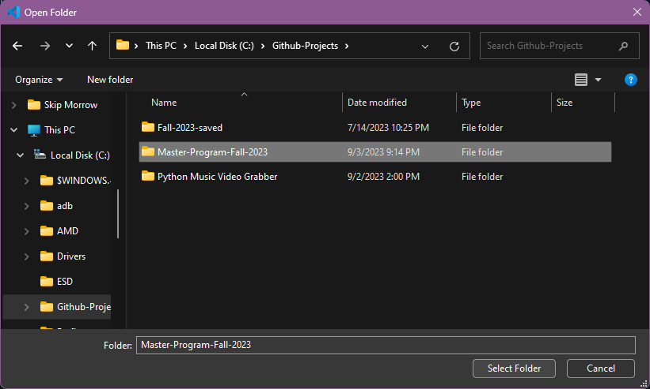
You should be saving your project in your Documents\FLL folder.

Slide 7
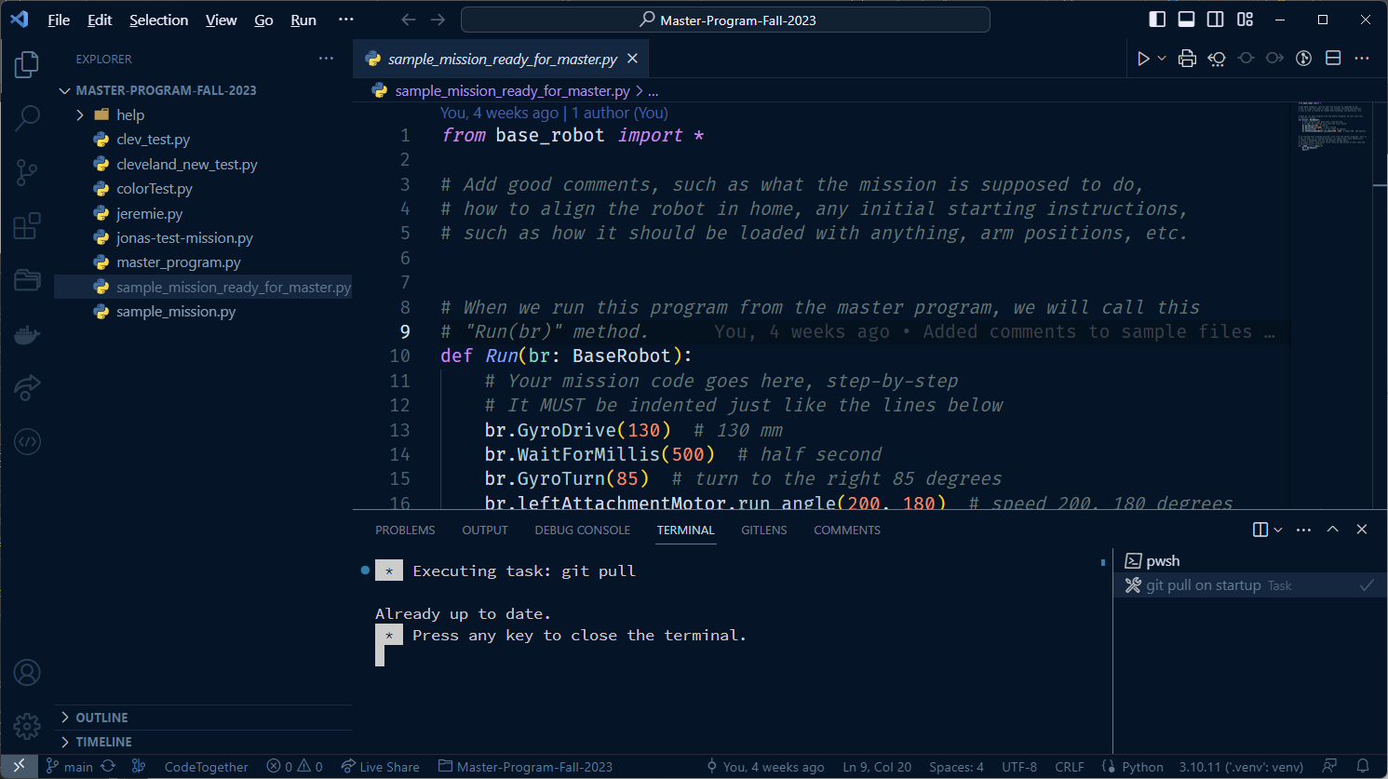
This will happen each time you open VS Code. If there are any errors, restart VS Code and they will probably go away.

Slide 8
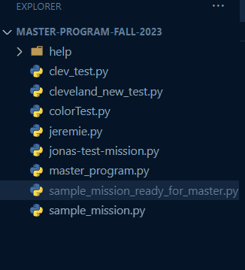
What are these files?
When the help folder is collapsed, all of the files here are the team mission files
You can create as many files as you need
Use all lower case and no spaces or special characters other than _ and –
Start each filename with your name
Include a meaningful mission name
Must end with “.py”
For example, “jonas-sound-mixer.py”
Do not edit files that aren’t yours!
Start with the sample_mission_ready_for_master.py

Slide 9
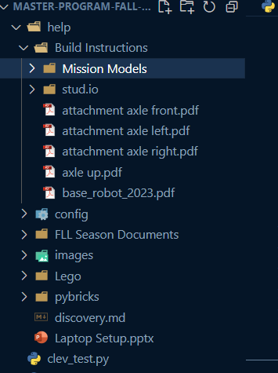
Build Instructions
Mission Models (should not need unless one of the mission models comes apart)
stud.io has the actual model for the base robot (should not need at all, unless you want to try and design a new base robot)
The pdf files however are very important as they will show you how to build a basic attachment

Slide 10
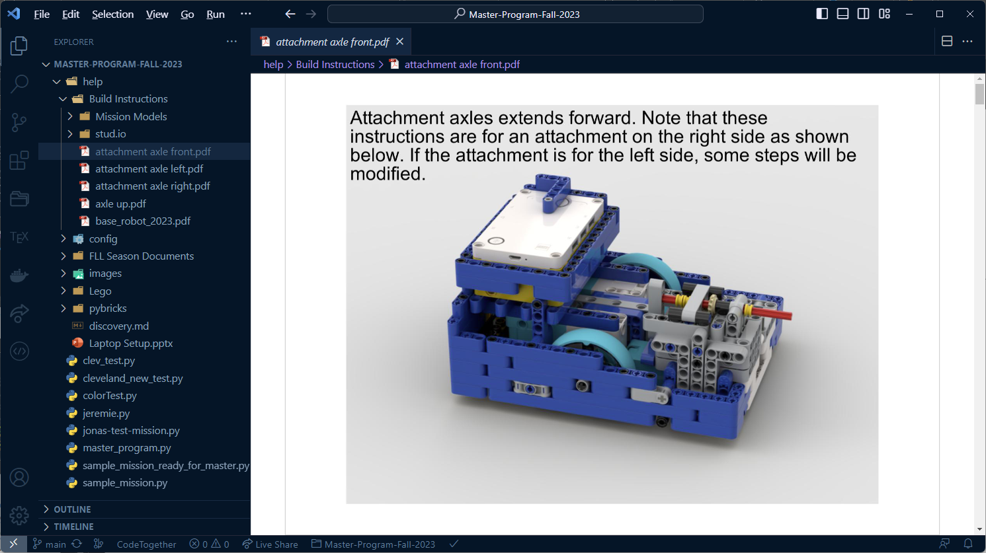

Slide 11
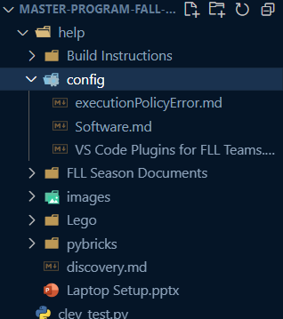
config has some files that are used on our github page. You will not need to do anything with any of these files.

Slide 12
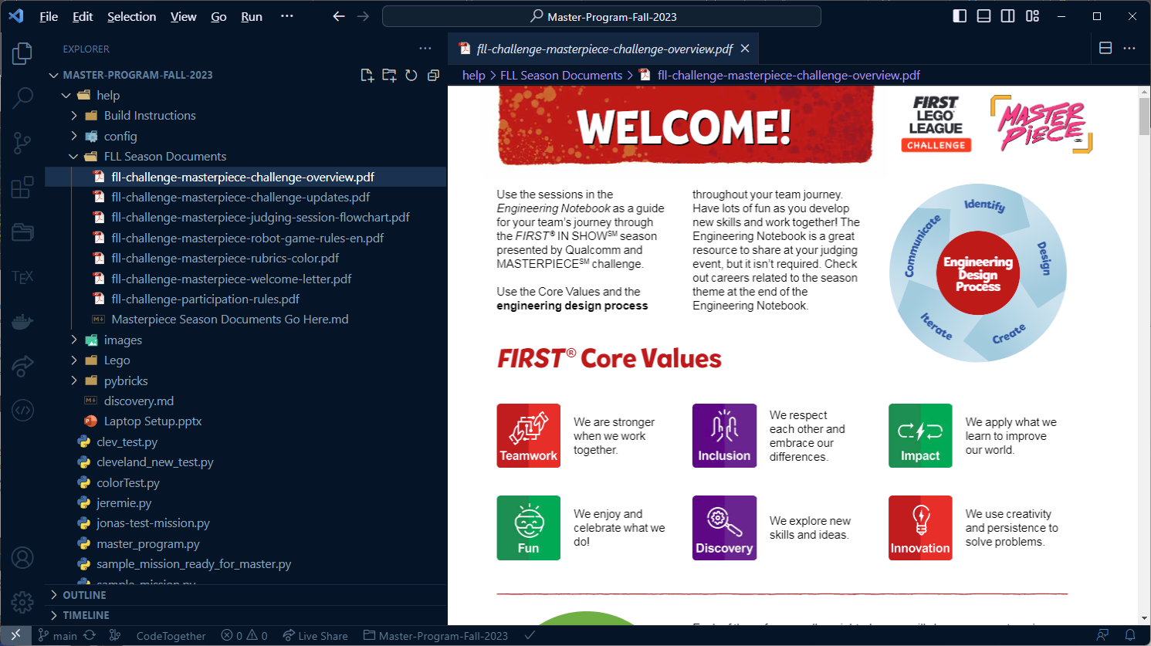

Slide 13
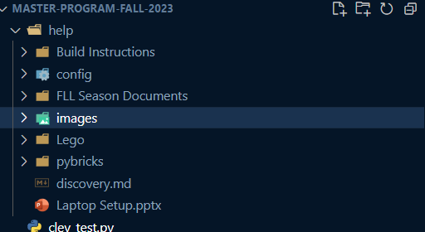
The images folder just has images that we may use for our presentations
The Lego and pybricks have official documentation that may come in handy if we have any questions about how the Spike robots work and how pybricks does things.

Slide 14
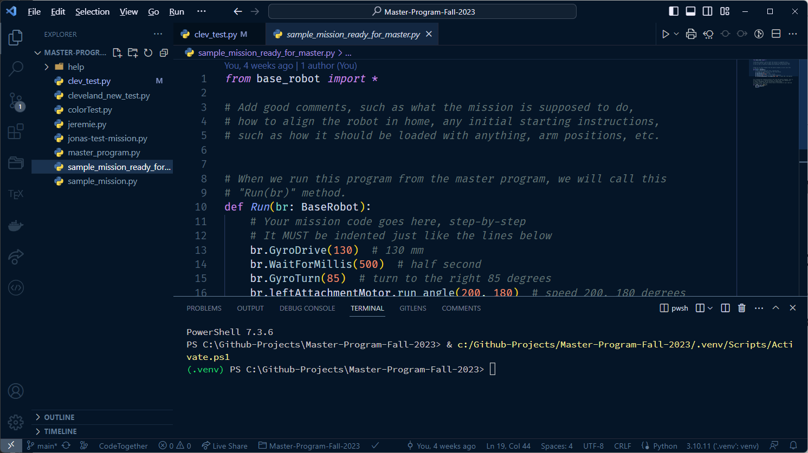
You can close this terminal while you are editing if you want more room on your screen

Slide 15
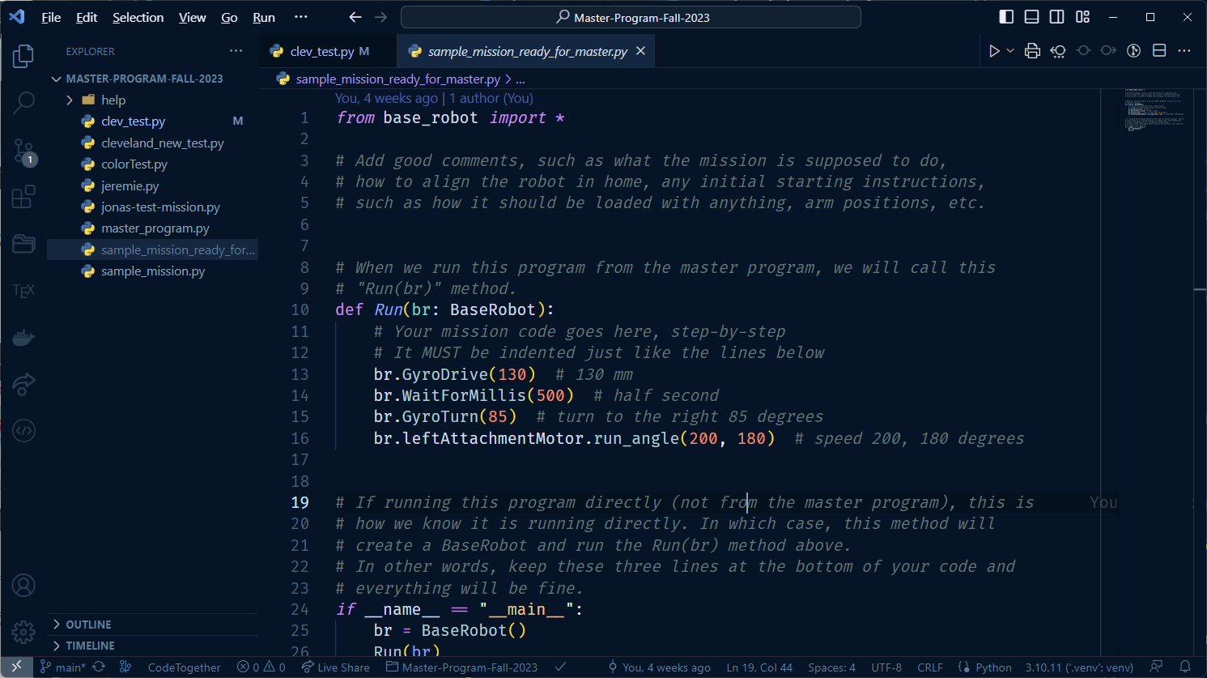
Ahhhh… so much better!

Slide 16
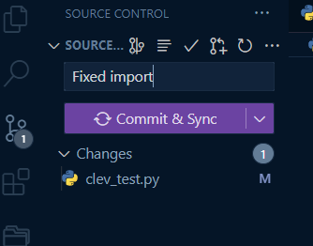
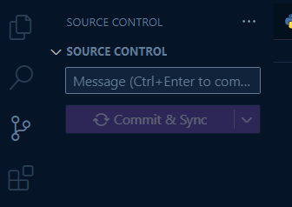
Github Commit and Sync
When you are ready to “push” or “commit” your updates, this is where you do it
Each commit must have a comment. Try your best to make your comments meaningful, but it’s not always easy.
Here I made an edit to Cleveland’s import statement, so my comment says what I did
You should do a push every day when you have written code
And do not edit or modify anyone’s files other than your own!

Slide 17
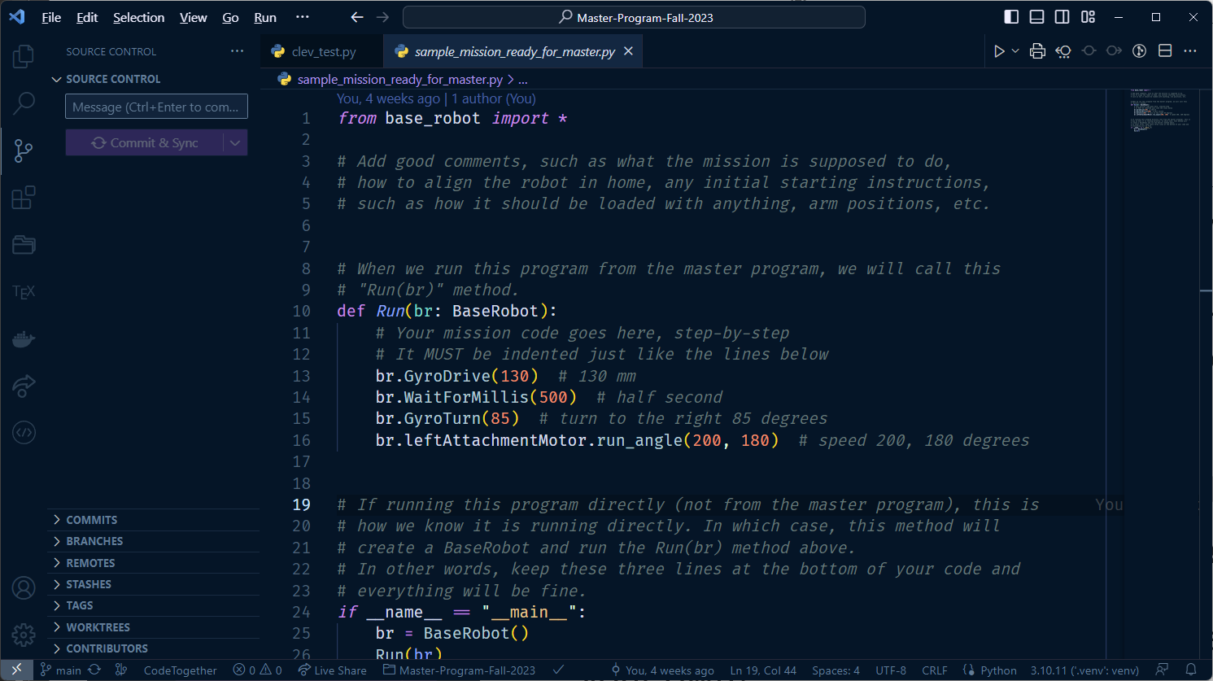
Don’t change this
Don’t change this either
This is your mission code area.
Don’t change anything below here

Slide 18
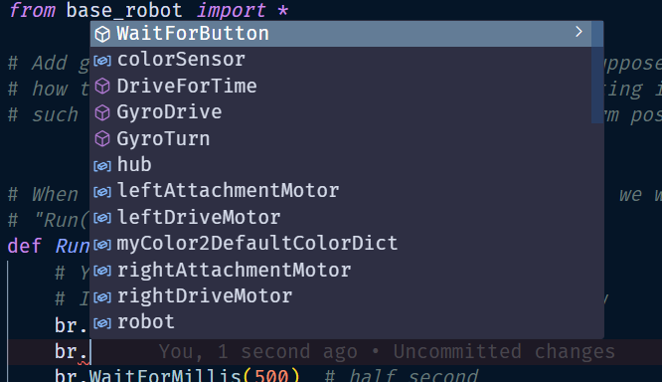
Code Completion
All of our commands will start with “br.”
Here I have typed “br.” and this popped up
You can scroll through this or continue typing and the list will get shorter

Slide 19
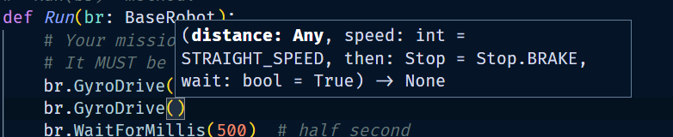
What goes in the parenthesis ()?
Cursor is right here
Once you type a “(“ open parenthesis, VS Code will help you
This tells us that the distance value is expected right now and any value is OK. This value is mandatory.

Slide 20
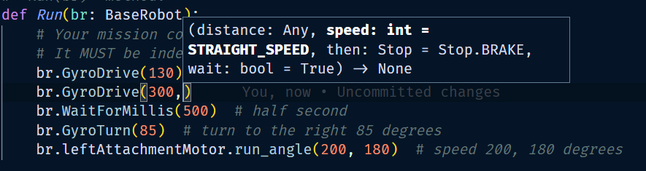
Cursor is right here
Here I have entered 300mm for the distance (note that I only have to enter the number 300. I should not put the “mm” in there
The next parameter is speed. This value must be an integer, but it is optional. We can see it is optional because the default value is listed here as “STRAIGHT_SPEED”. The distance did not have a default, so it was required.
You have the choice of what speed you want to use. The default speed is good for most situations, but sometimes you want to go faster or slower.

Slide 21
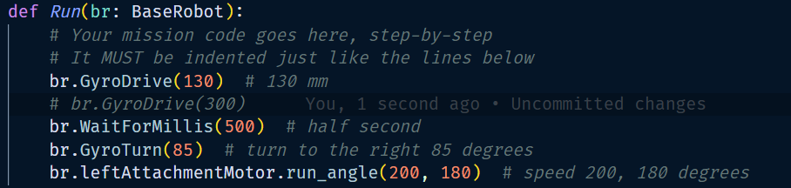
Comments
Comments are used for two reasons
Documenting code is the most important. This code does have some comments, but not very good.
You can also comment out code that you temporarily do not want to run. Here I have commented out the line I just wrote because it doesn’t really make sense to have two GyroDrive commands in a row. Type ctrl-/ to comment and uncomment lines.

Slide 22

Order matters… or does it?
Here we are going to move the left attachment motor. We want it to go at speed 200 for 180 degrees.
All three of these lines do the same thing, but the bottom two are a little easier to read
The first one has to enter the parameters in the correct order: speed followed by rotation angle

Slide 23
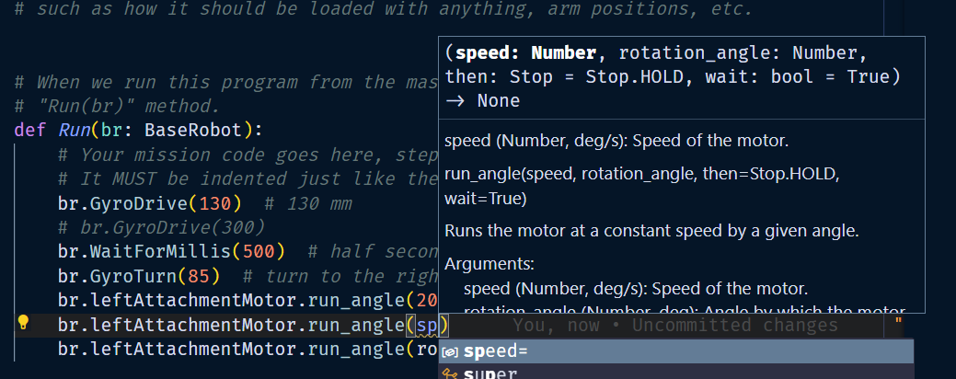
Code Completion helps

Slide 24
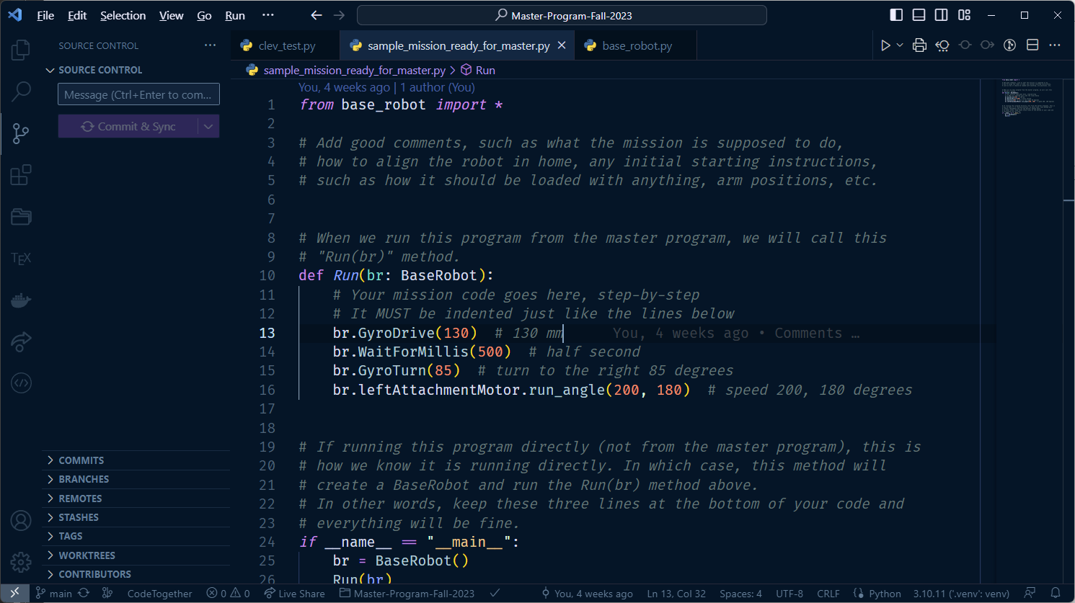
All of our mission code must be indented

